Slide 1

BLOOD DONATION MANAGEMENT SYSTEM
SHIVA KANT MISHRA
Adm no. 2019B111033
Roll no. -1900321290057

Slide 2
CONTENTS:::
1. Problem Introduction
a. Motivation
b. Project Objective
c. Scope of the Project
2.Related previous work
3.Software & Hardware Requirement
4.Proposed Methods
5.Deliverables
6.Stakeholders
7.Gantt Chart
8. References
9.Conclusion

Slide 3
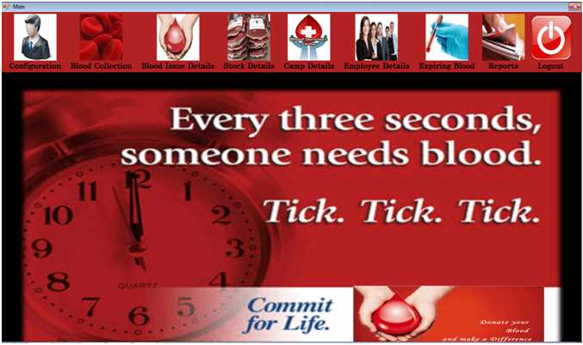

Slide 4
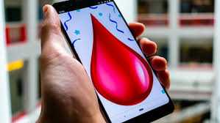
INTRODUCTION
Blood management system is to maintain the day to day tranctions in blood bnk.the software helps to register all donars. Blood colletions details and blood issued details.
objective is only that a healthy blood should reach to the needy one at the right time.

Slide 5

OBJECTIVE
The objective of this application is to devloping an online Blood Donation information.
Easily search the donor list
This system is used for maintain whole info. About donar,receivers.

Slide 6

MOTIVATION
In a digital era everyone wants to get their work faster .we saw that lot people die due to unavailabilty of blood and on seeing this type of problem you should move a one step ahead and the save the life of other who are in need.
BECAUSE::

Slide 7
Scope::
In future , we can add the stock information of blood and maintain the supply and utility of blood in efficient way.
We can also add a feature in which needed one can search donor detail through just sending a message through simple Phone .

Slide 8
Related Previous Work
1.Bloodbanktoday
The website for Blood Bank India is a website that provides the facility for the donor to register by him or herself as a blood donor.It also provides a feature where a person can request blood from bloodbanktoday.It also provide a list of blood bank which can easily search by just entering the state and district .This website not provides the stock information of blood .In this website we can donate fund also for good cause.
https://bloodbanktoday.com/

Slide 9
2.ebloodbankodisha
Ebloodbankodisha is a goverment organization that helps to donate blood. This website provide information about blood stock but we can not registered as a donor we have to visit to a blood bank to register .we can login as a blood bank user,and a state user.This website not provide the donor information for all user .
https://ebloodbankodisha.nic.in/Websites/frontPage

Slide 10
TECHNOLOGIES USED
Visual Studio.net
HTML
CSS
JQUERY
BOOTSTRAP FRAMEWORK
MySQL Server

Slide 11
Software Requirements
DBMS Software(XAMPP)
Visual studio.net
Windows 10
Google Chrome/ Firefox/ Internet Explorer 10+/ Edge/ Safari/Opera
Hardware Requirements
Hard Disk – 2GB
RAM – 1 GB.
Processor – Dual Core or Above

Slide 12
EXISTING SYSTEM
Time consuming.
Consumes lot of manpower to better results.
Lacks of data security.
Retrieval of data takes lot of time.
Percentage of accuracy is less.

Slide 13
PROPOSED SYSTEM
System makes the overall project management much easier and flexible.
Upload th latest updates,allows user to see the alters by clicking the URL.
It provides high level of security with different level of authentication.
User friendliness we provided in the application with various controls.

Slide 14
MODULES
Login Module
Admin
User

Slide 15
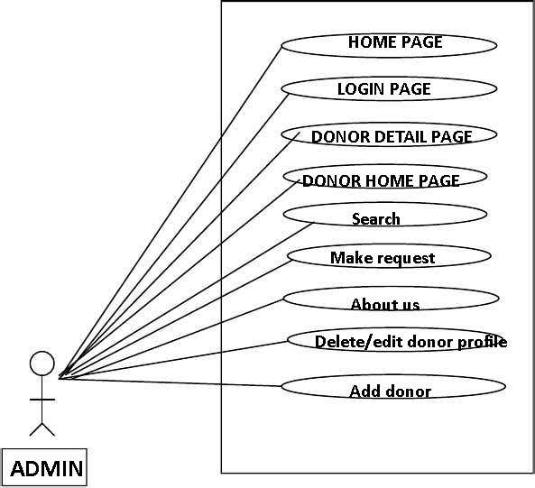
UML DIAGRAM:ADMIN

Slide 16
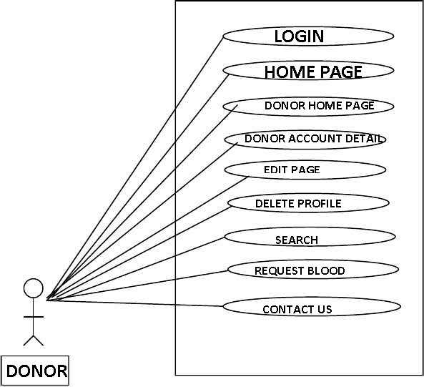
UML DIAGRAM:DONOR

Slide 17
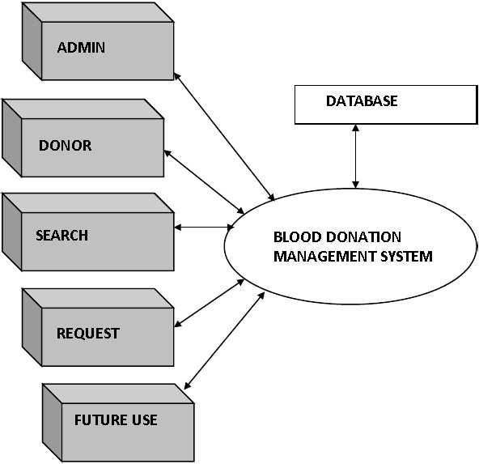
DATA FLOW DIAGRAM

Slide 18
ACTIVITY DIAGRAM:DONOR
LOGIN
UPDATE
PROFILE
DELETE PROFILE
LOGOUT

Slide 19
ACTIVITY DIAGRAM:ADMIN
LOGIN
SEE ALL DONOR DETAIL
DELETE/EDIT PROFILE OF DONOR
ADD DONOR
LOGOUT

Slide 20
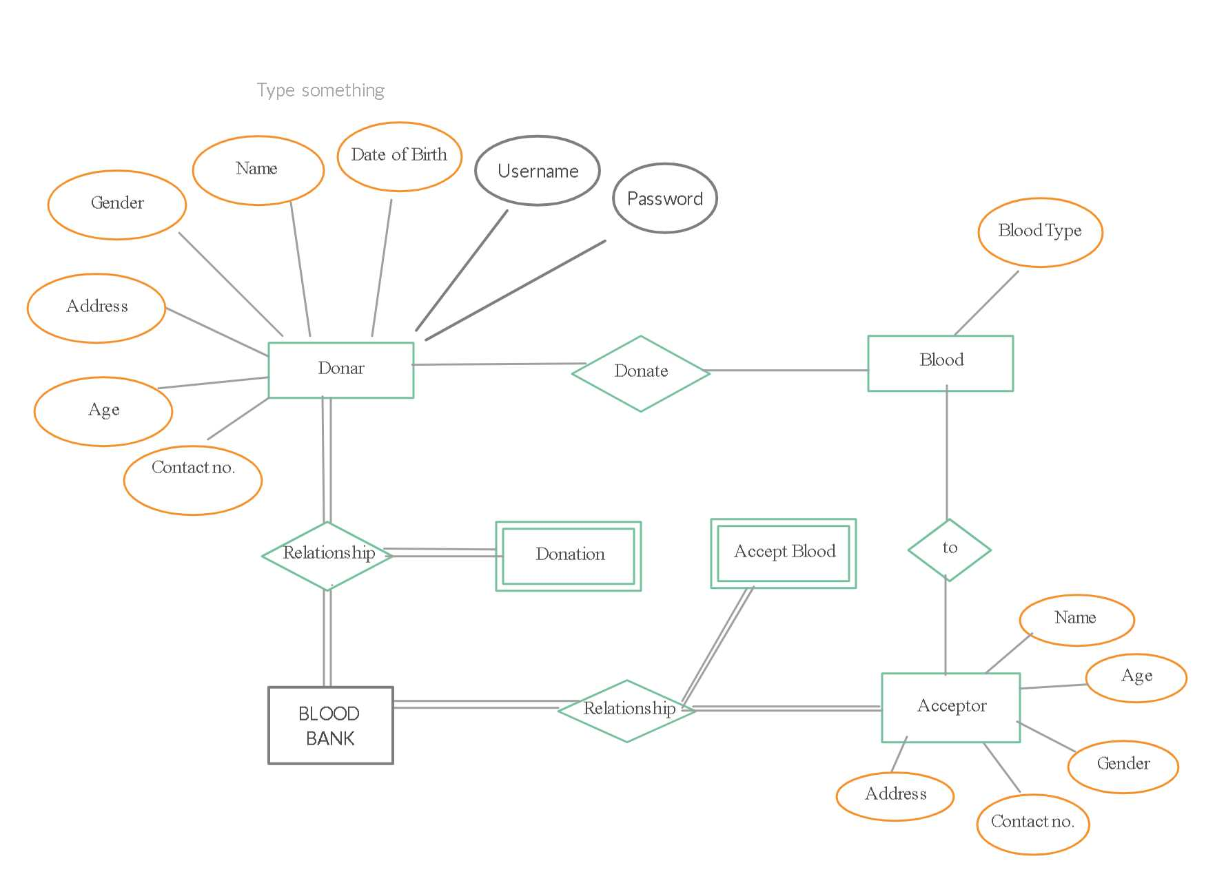
ER DIAGRAM

Slide 21
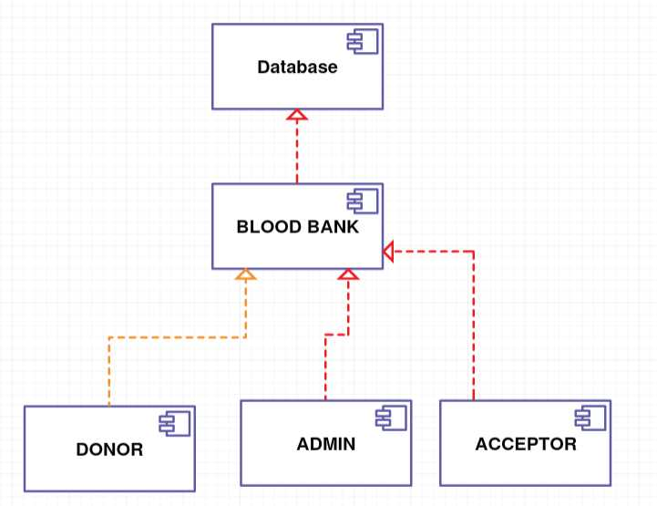
COMPONENT DIAGRAM::

Slide 22
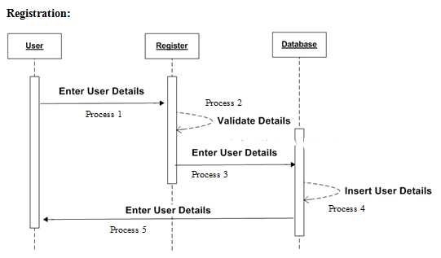
SEQUENCE DIAGRAM

Slide 23
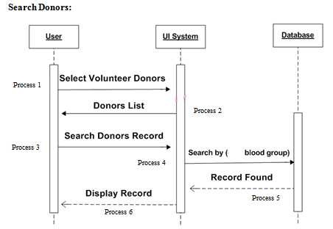
SEQUENCE DIAGRAM

Slide 24
OUTPUT SCREEN

Slide 25
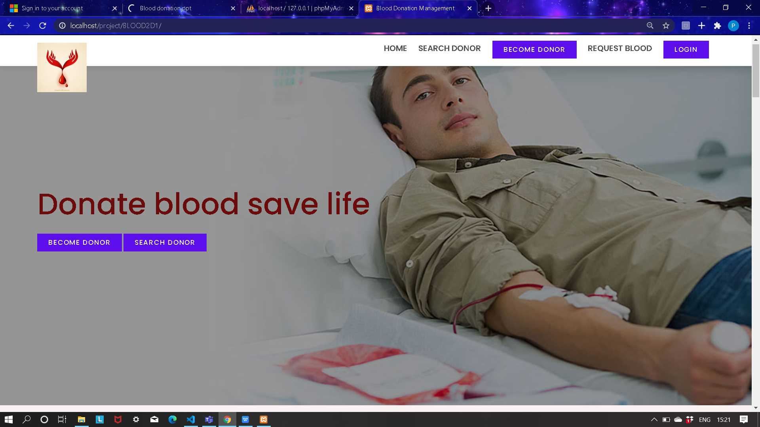
Home page

Slide 26
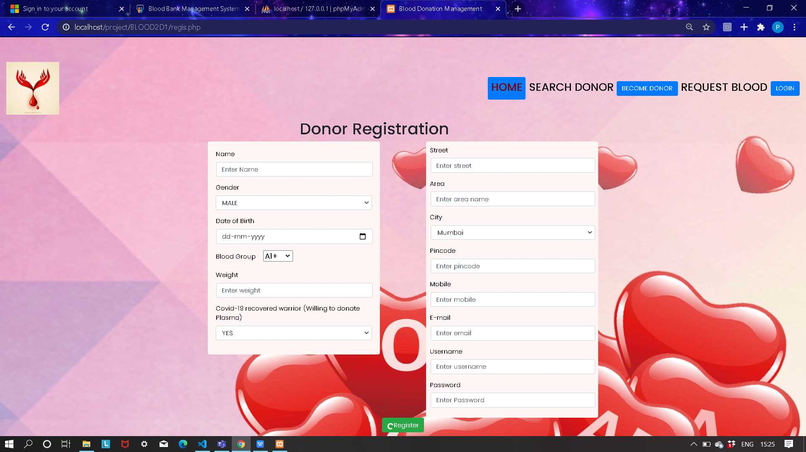
DONOR REGISTRATION

Slide 27
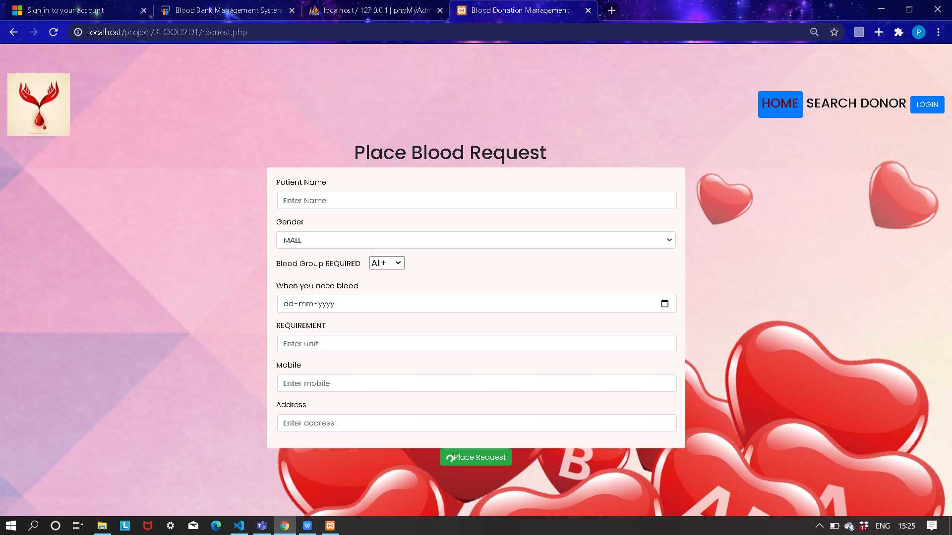
BLOOD REQUEST

Slide 28
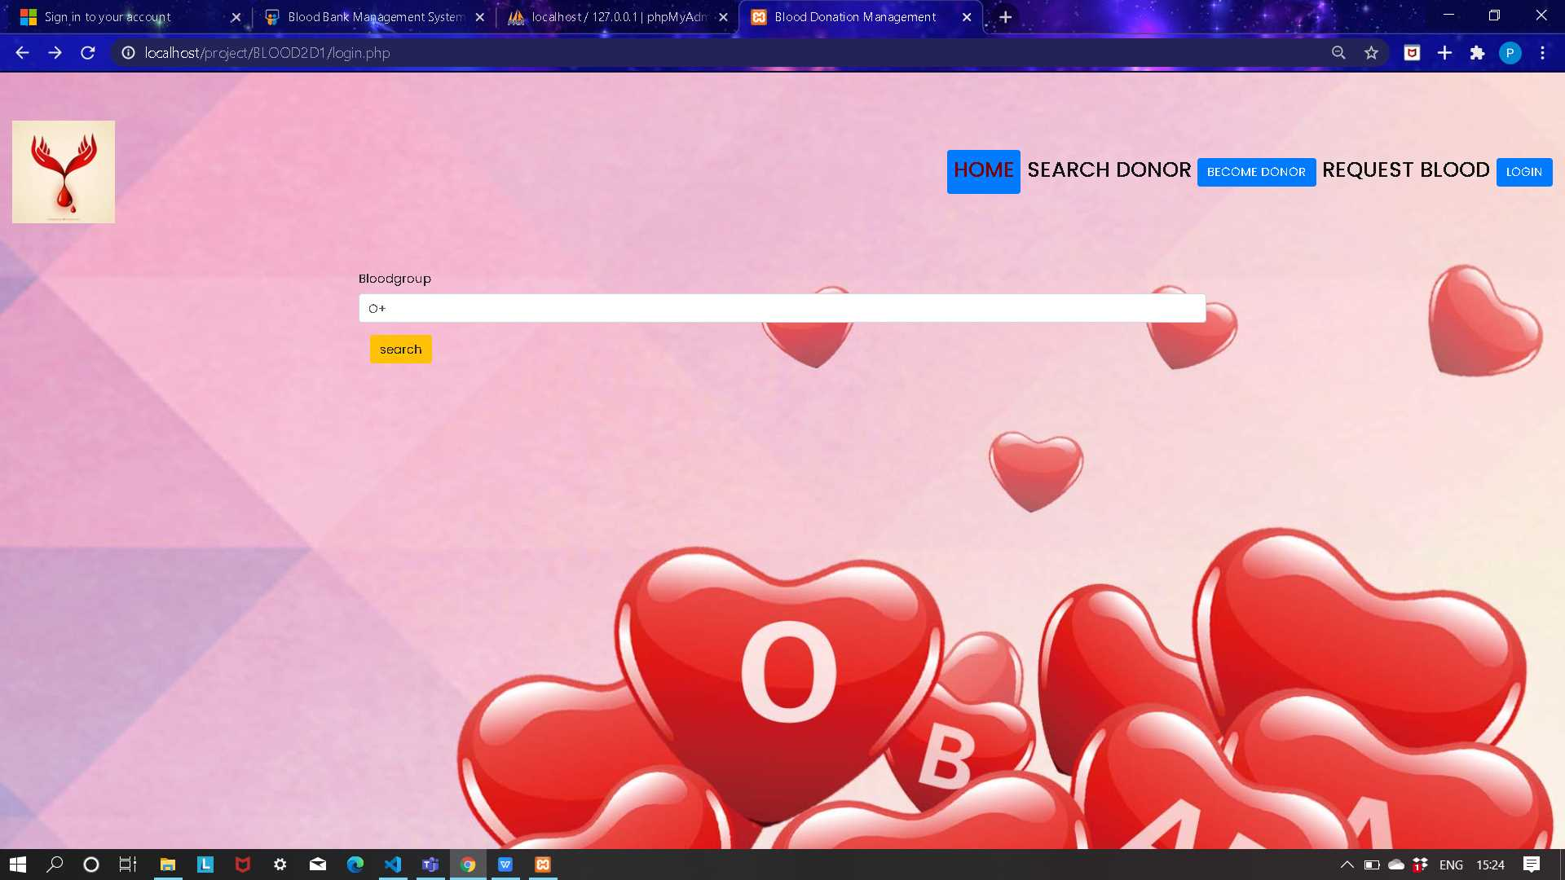
Search Donor

Slide 29
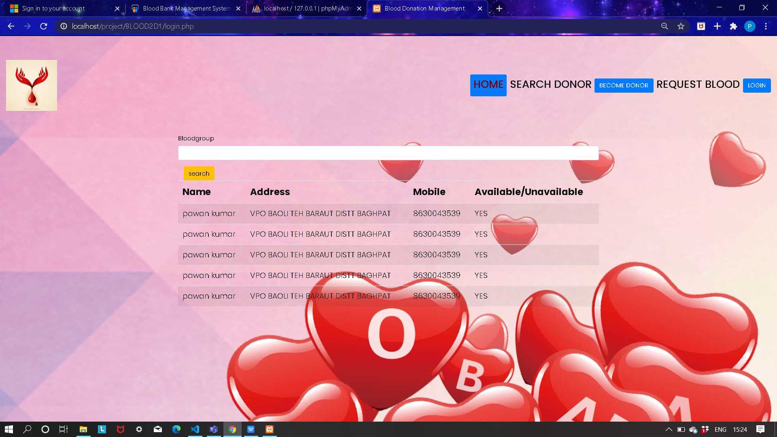
DONOR LIST

Slide 30
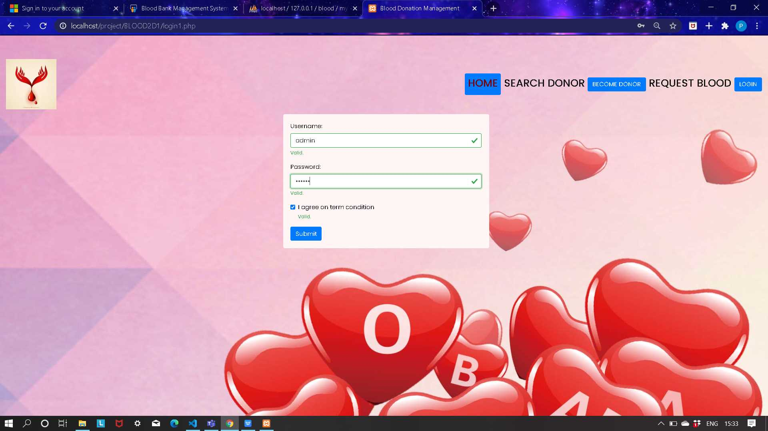
ADMIN LOGIN

Slide 31
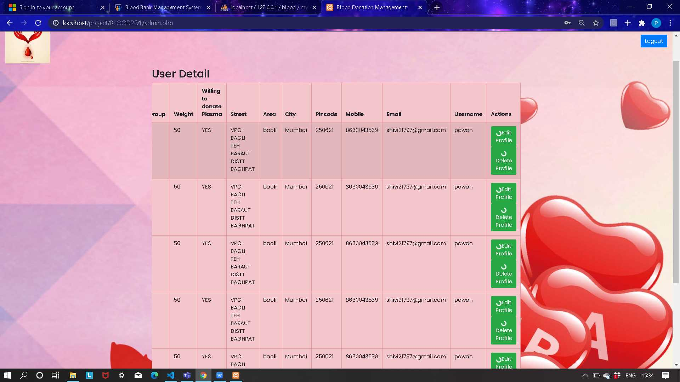
ADMIN PAGE

Slide 32
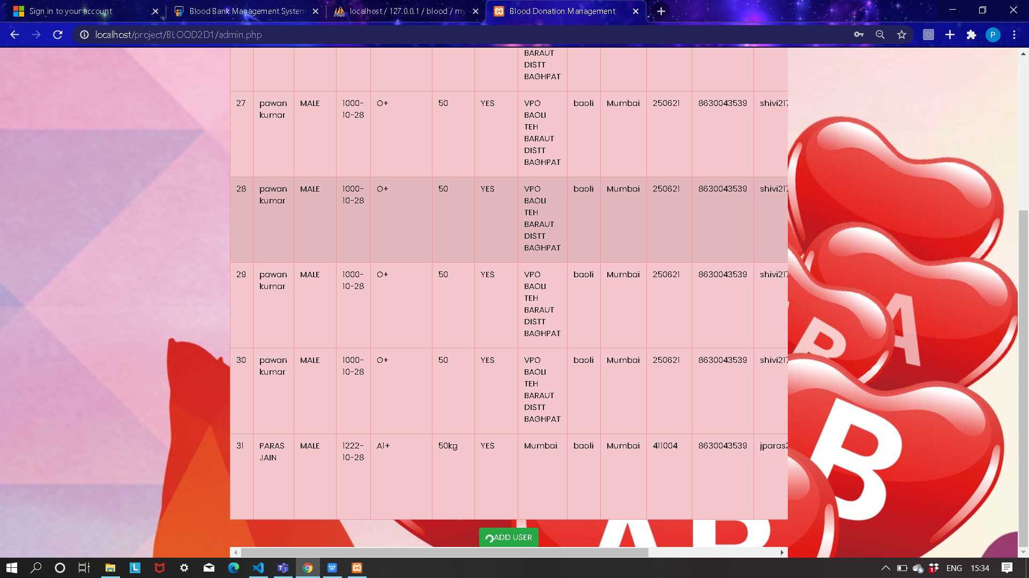
ADMIN PAGE

Slide 33
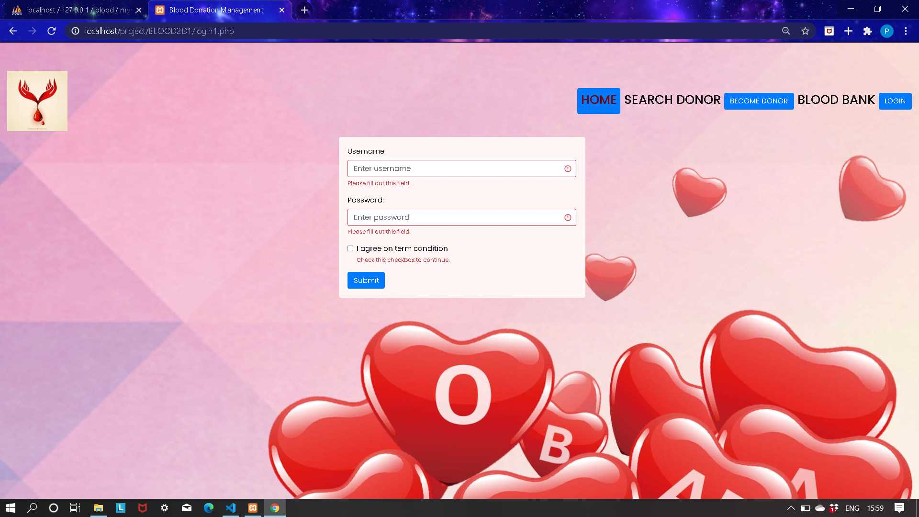
USER LOGIN

Slide 34
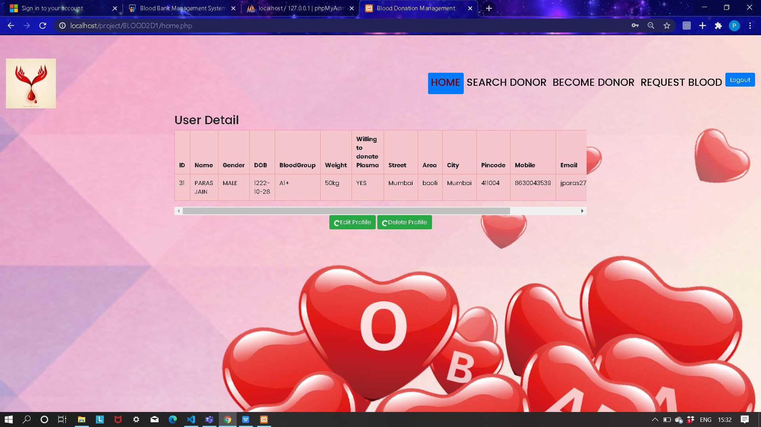

Slide 35
STAKEHOLDER
Patients in need for blood: Patient who are in need of blood can easily take benefit of our application.
Hospitals : hospitals often require blood for transfusion and our application can make there work easier.

Slide 37
REFERENCES
Vikas Kulshreshtha, Sharad Maheshwari. (2011).”Blood Bank Management Information System in India”, International Journal of Engineering,
1,2, 260-263.
E- Blood Bank & Research Foundation. (2012). Retrieved from https://ebloodbankodisha.nic.in/Websites/frontPage
Blood Bank Today. (2012). Retrieved from https://bloodbanktoday.com/
W3Schools Online Web Tutorials used for learning how to connect database to our website

Slide 38
CONCLUSION
Today the world is become a global village where every thing is online.
There are so many web based solutions provided in the marked for the comfort of the peoplr.
But without blood human being is non living,just by providing the web solution of blood bank management info. System is just one more step in order to serve the mankind.

Slide 39


Slide 40


